Slide 1




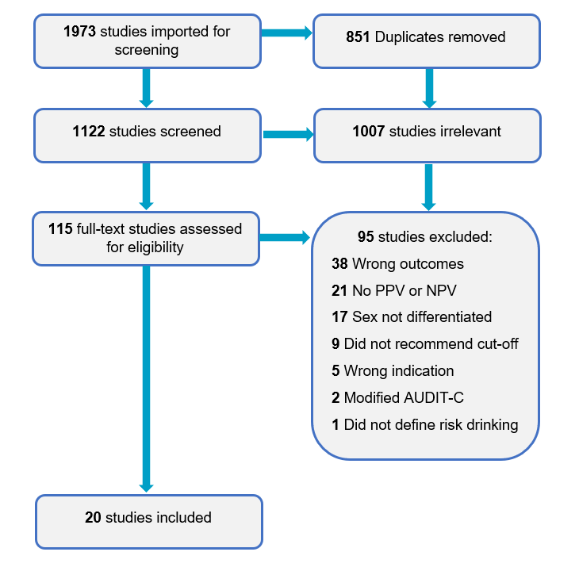
Which AUDIT-C cut-off?
Preliminary results from a systematic review of AUDIT-C thresholds for males and females
The AUDIT-C is a widely used three item screening instrument for heavy drinking and/or active dependence, ^{[1]} which comprises the first three questions of the AUDIT. Widely used cut-off scores to indicate risk are three for females and four for males. ^{[2]}
Alcohol-related risk varies by sex and age. Several studies have suggested that depending upon the population being screened different AUDIT-C cut-offs may be warranted. ^{[3-6]}
The AUDIT-C is a widely used three item screening instrument for heavy drinking and/or active dependence, ^{[1]} which comprises the first three questions of the AUDIT. Widely used cut-off scores to indicate risk are three for females and four for males. ^{[2]}
Alcohol-related risk varies by sex and age. Several studies have suggested that depending upon the population being screened different AUDIT-C cut-offs may be warranted. ^{[3-6]}
Jane A. Fischer¹ & Vinita Duraisingam¹
jane.fischer@flinders.edu.au
¹National Centre for Education and Training on Addiction, Flinders Health and Medical Research Institute, Flinders University, Adelaide, South Australia, Australia
Background
Method
    The AUDIT-C is a widely used three item screening instrument for heavy drinking and/or active dependence (1), comprising the AUDIT consumption questions. Widely used AUDIT-C cut-off scores: three for females and four for males (2).
    Risk varies by sex and age. Several studies have recommended AUDIT-C cut-offs be dependent upon screening context (3-6).
Systematic review of recommended optimal AUDIT-C cut-offs for males and females, and associated sensitivity (Se), specificity (Sp), Positive Predictive Value (PPV) and Negative Predictive Value (NPV).
PubMed, Web of Science and Scopus databases were searched with the following terms AUDITC OR AUDIT-C OR Alcohol Use Disorders Identification Test – Consumption AND human AND English (Figure 1).
Results
Optimal cut-off scores (N=20 studies, Table 1)
Males (n=18 studies)
Mean (M) cut-off score recommended: ≤5.5 (Median: ≤5, Mode: ≤5, Range: ≤2 - ≤9)
Eight studies reported cut-off score of ≤5, with mean:
  Se: 80.9% (range: 69% - 91%)
  Sp: 78.4% (range: 73% - 85%)
  PPV: 51.9% (range: 29% - 65%)
  NPV: 92.3% (range: 82% - 97%)
Females (n=18 studies)
Mean (M) cut-off score recommended: ≤4.44
  (Median: ≤4, Mode: ≤4, Range: ≤2 - ≤8)
Seven studies reported cut-off score of ≤4, with mean:
  Se: 88.7% (range: 70% - 100%)
  Sp: 84.1% (range: 68% - 95%)
  PPV: 48.7% (range: 20% - 90%)
  NPV: 88.3% (range: 52% - 100%)
Figure 1: Flow diagram of included studies
Table 1: Recommended optimal AUDITC cut-offs for males and females
Notes Key: Ss: sample size, ED emergency department presentations, Rx: Treatment, na: not applicable, NR: not reported, Se: sensitivity, Sp: specificity, PPV: Positive Predictive Value; NPV: Negative Predictive Value, A: alcohol-related problem & any binge drinking, B: 140g ethanol per week on average in past month, C: ≥10 units per week, D: 36g ethanol in one session & 98g ethanol per week, E: 17 units a week, F: ≥7 units a week or 4 heavy episodes past month, G: AUDIT ≥11, H: DSM-5, I: DSM-IV, J: AUDIT ≥6, K: AUDIT ≥7, L: AUDIT ≥8, M: Mean ≥12g ethanol daily in last 12 months, N: ≥60g ethanol per drinking occasion, O: ≥4 in a day or ≥7 per week, P: 35 units per week, Q: 56g ethanol in one session & 196g ethanol a week, R: ≥14 a week or 4 heavy episodes past month, S: 70g ethanol, T: 280g ethanol per week, U: Mean ≥24g ethanol daily in last 12 months, V: 50 units of alcohol per week
Implications
Implications
Recommended optimal scores for males and females were found to be higher than those commonly used (2). However, the broad range of cut-off scores found for males and females emphasise the importance of sex and population context when determining appropriate AUDIT-C cut-off points in clinical and research settings. No included studies were conducted in Australia. Future directions should consider improving understanding of the useability and utility of the AUDIT-C amongst Aboriginal and Torres Strait Islander peoples (7, 8), online help-seeking (9) and in guiding intervention selection (10).
References: 1.Verhoog, S., et al., The Use of the Alcohol Use Disorders Identification Test - Consumption as an Indicator of Hazardous Alcohol Use among University Students. EUROPEAN ADDICTION RESEARCH, 2020. 26(1):1-9. 2. Bradley, K.A., et al., AUDIT‐C as a brief screen for alcohol misuse in primary care. Alcoholism: Clinical and Experimental Research, 2007. 31(7):1208-1217. 3. Babor, T.F. & K. Robaina, The Alcohol Use Disorders Identification Test (AUDIT): A review of graded severity algorithms and national adaptations. International Journal of Alcohol and Drug Research, 2016. 5(2):17-24. 4. Fischer, J.A., et al., Alcohol Use Disorders Identification Test - Consumption (AUDIT-C): description, strengths and knowledge gaps. 2021, NCETA, Flinders University: Adelaide. 5. Higgins-Biddle, J.C. & T.F. Babor, A review of the Alcohol Use Disorders Identification Test (AUDIT), AUDIT-C, and USAUDIT for screening in the United States: past issues and future directions. American Journal of Drug and Alcohol Abuse, 2018. 44(6): 578-586. 6. Nadkarni, A., et al., Auditing the AUDIT: A systematic review of cut-off scores for the Alcohol Use Disorders Identification Test (AUDIT) in low-and middle-income countries. Drug and Alcohol Dependence, 2019. 202:123-133. 7. Islam, M., et al., Standardised alcohol screening in primary health care services targeting Aboriginal and Torres Strait Islander peoples in Australia. Addiction Science and Clinical Practice, 2018. 13(1):1-11. 8. Lee, K.K., et al., Short screening tools for risky drinking in Aboriginal and Torres Strait Islander Australians: modified AUDIT-C and a new approach. Addiction Science and Clinical Practice, 2019.14(1):1-12. 9. Khadjesari, Z., et al., Validation of the AUDIT-C in adults seeking help with their drinking online. Addiction Science and Clinical Practice, 2017. 12(1). 10. Wade, D., et al., The Alcohol Use Disorders Identification Test‐Consumption (AUDIT‐C) in the Assessment of Alcohol Use Disorders Among Acute Injury Patients. Alcoholism: Clinical and Experimental Research, 2014. 38(1):294-299.
Acknowledgements
This work was funded by the Australian Government: Department of Health
Thank you to Dr Alice McEntee, Ms Jules Johnson & Mr Armin Muminovic, NCETA.
LARRAKIA Country
We acknowledge the traditional custodians, the Larrakia people, of the land on which the Darwin Convention Centre stands.
We pay our respects to their Elders past and present and remain committed to working together to care for this land.

